Slide 1
SIH INTERNAL HACKETHON
PHASE 1 – IDEA SELECTION
TEAM LEADER : HAREETHA K
TEAM LEADER ROLL NO :182IT137
CATEGORY :HARDWARE
PS CODE :AG344
ORGANIZATION :MATHWORKS
PROBLEM STATEMENT :SMART TRAFFIC MONITORING AND CONTROLLING
PROBLEM DESCRIPTION :Traffic control for the people, by the people”. The smart phone-based Application captures the traffic flout and directly share it with traffic control team. App will have information about Traffic rules with best user interactive appearance. App will reduce Burden on traffic control team. PROBLEM STATEMENT: The traffic is huge problem in metro cities in India and to monitor it throughout a day it’s the difficult task. The Traffic control and monitoring team can control this up to certain extent. However, the main responsibilities lie on individual. The simple smart phone-based application has capability to record the rule breaking and flout traffic situation which will be shared with traffic control team (Traffic Police). In current situation, the traffic control team uses a camera to capture people with flouting traffic rules and along with this they have to control the city traffic too. It is difficult for them to keep an eye on both the activities at a time. To reduce their workload, an individual can install this app and will be able to share the evidence with traffic control team. The awareness of this app will lead an individual to follow traffic rule strictly in order to avoid mistakes done by others. The app will have traffic rule guidelines which will help an individual to learn more about traffic rules. The app will provide credit to user on capturing valid traffic flout. The App can cover large scale to small scale Traffic rule evades (e. g. No Parking, Pedestrian crossing evades). Each individual can contribute toward traffic control, awareness, and behavior of individual toward traffic rules. OUTCOME EXPECTED: 1. Application runs on Android and IOS app which is directly integrated with traffic control team. 2. Distributed way of traffic maintenance. MATHWORKS PRODUCTS: FREE SOFTWARE WILL BE PROVIDED TO STUDENT TEAMS ThingSpeak, Image processing toolbox, Computer vision toolbox, Mapping and Navigation, Image Acquisition toolbox, MATLAB Coder, Simulink and MATLAB MATHWORKS WILL PROVIDE FREE SOFTWARE(MATLAB, SIMULINK AND TOOLBOXES) TO ALL STUDENT TEAMS PARTICIPATING IN THE HACKATHON

Slide 2
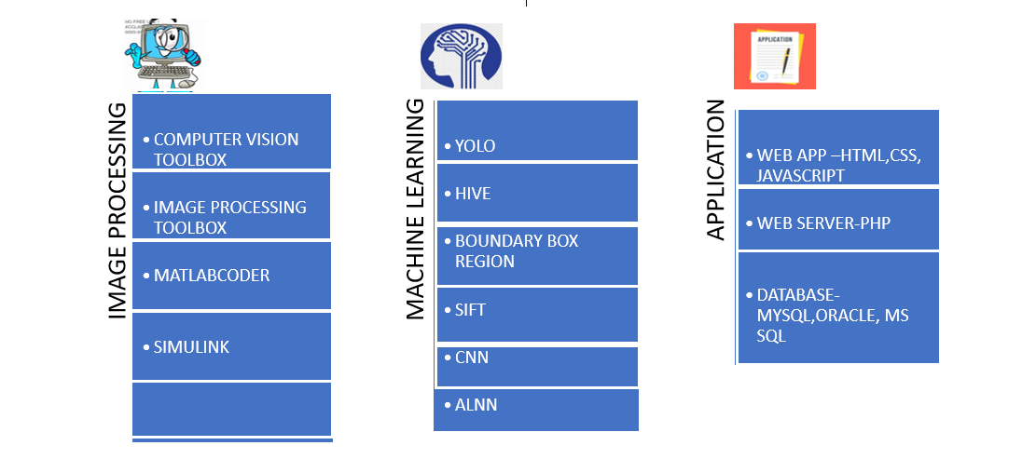

Domain: Smart Traffic Monitoring And Control.
Problem statement: To control the traffic and spot the vehicle violating the traffic rules using MATLAB.
Team Leader Name: Hareetha k
IDEA
The LPR CAMERA( with zoom lens 8-32mm and 1080p) with video capturing range of 100 feet is used for monitoring vehicles moving with the speed of 100-120km/h and the recorded video is recoded as an image with 60 frames/sec.
The images of the vehicles are processed using MATLAB for identification of number plate in vehicles which are violating the rules like passing and parking prohibition using Machine learning Algorithm such as YOLO and BOUNDARY BOX REGION. The text and character recognition accuracy of this technique is 95%.
When online, the information of the captured number plate with vehicle’s location is sent to the police as a notification via app using server programs and data can be retrieved which is cached as buffer when the internet connection is lost. Also the captured video evidence can be uploaded in this app by an individual.
Penalty can be imposed on the defaulters automatically.
TECHNOLOGY STACK

Slide 3

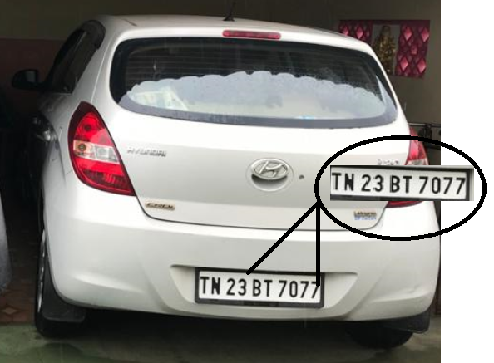
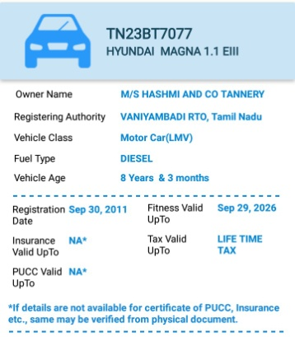


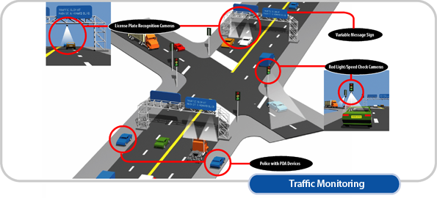
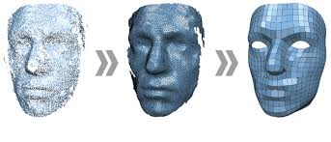




USE CASE
LICENSE CAPTURE CAMERA
ZOOMED NUMBER PLATE OF A CAR ( MParivahan app)
NUMBER PLATE COMPARING WITH THE DATABASE
IMAGE PROCESSING TECHNIQUE DETAILS ARE SENT TO THE SERVER
LICENSE PLATE DETECTION CHARACTER SEPERATION OF NUMBERS USING RGB TO GREY FINALLY CAUGHT BY NOTIFIES THROUGH
SCALE CONVERSION METHOD COPS APP (HELA)
DEPENDENCY
This app doesn’t work in offline but the data are stored in buffer (temporary storage) and it can be retrieved when we are online
T | N | 2 | 3 | B | T | 7 | 0 | 7 | 7

Slide 4
ACHIEVEMENTS OF TEAM MEMBERS
TEAM MEMBER NAME | EVENT NAME | ORGANISER | INTERNATIONAL/ NATIONAL/STATE LEVEL | DETAILS OF PRIZES/ PARTICIPATION
Hareetha.K | Srishti 2019 | SaintGits college of Engineering | National Level | Participation in Final round

